Slide 1



Dual Graph Attention Networks for Deep Latent Representation
of Multifaceted Social Effects in Recommender Systems
·
·
·
Qitian Wu¹, Hengrui Zhang¹, Xiaofeng Gao¹, Peng He²,
Paul Weng³, Han Gao², Guihai Chen¹
¹Shanghai Key Laboratory of Scalable Computing and Systems, Department of Computer Science and Engineering, Shanghai Jiao Tong University
²WeChat, Tencent Inc.
³UM-SJTU Joint Institute, Shanghai Jiao Tong University
Notes:
Good afternoon, ladies and gentleman, my name is Qitian Wu, a first-year master student from Shanghai Jiao Tong University. Today I will introduce our paper, dual graph attention networks for deep latent representation of multifaceted social effects in recommender system. This is a collaboration work of Shanghai Jiao Tong University and Tencent.

Slide 2


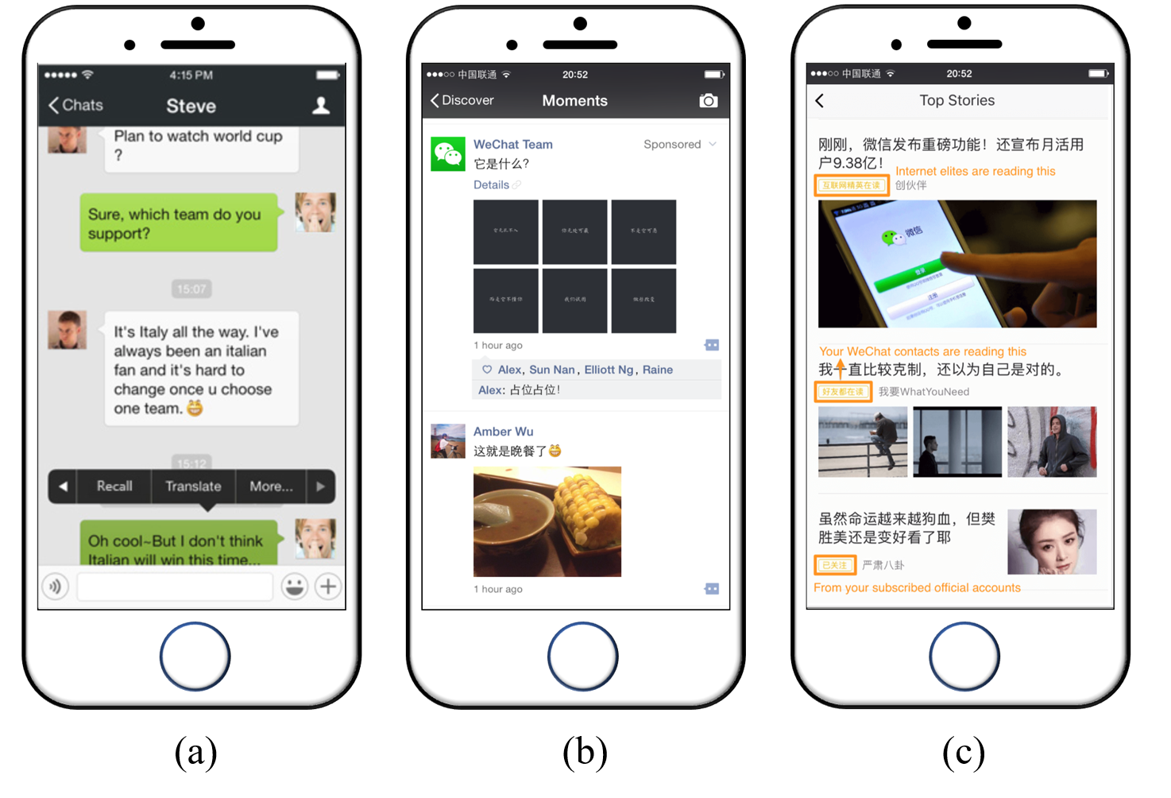
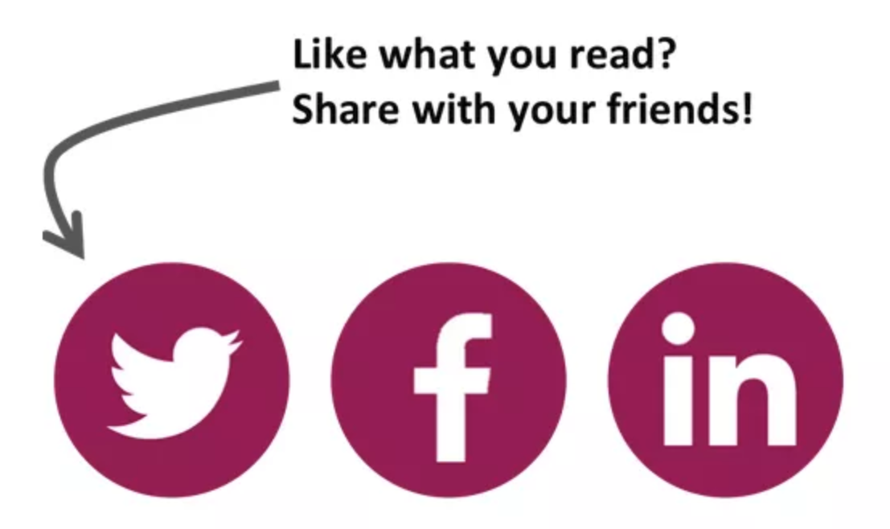
Problem
·
·
·
Top Stories on WeChat
The Web Conference 2019
Qitian Wu @ SJTU
Wed 15th 2019
1/21
·
Notes:
Let us start with the research background. Recommender system, which aims at selecting some key contents of user’s potential interest from a large quantity of information, plays an important role in alleviating nowadays information explosion problem. Previous recommendation algorithm leverage historical user-item interactions to estimate user’s preference and recommends items that match one’s interest. However, nowadays, people’s preference and interests would also be influenced by their friends through social interactions. For example, on Wechat, one of the largest Chinese social app. People can post their texts and images through one public community named WeChat Moments. Such posted content would influence the exposure of some items to specific users as well as affect user’s preference on certain kinds of items. This social effect phenomenon inspires a newly released application named Top Stories on WeChat, which can recommend articles to users based on one’s friends similar behaviors and interests.

Slide 3
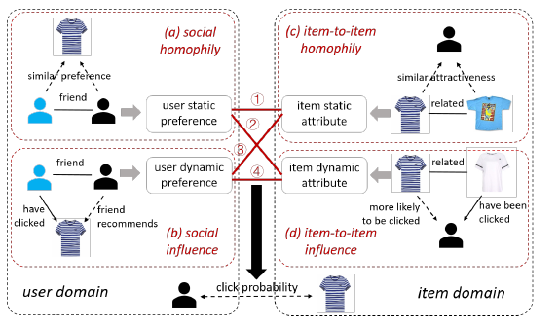
Motivation
·
·
·
four-fold social effects:
social homophily
social influence
item-to-item homophily
item-to-item influence
The Web Conference 2019
Qitian Wu @ SJTU
Wed 15th 2019
2/21
·
Notes:
In specific, there are totally four kinds of different social effects in both user and item domains. The first one is social homophily, which means that friend users tend to possess similar preference on the same item. The second one is social influence, which means that friend’s behavior would influence user’s behavior. For example, if one user has bought one item and he recommends it to his friends, then such word-of-mouth marketing would increase the probability of user clicking on one item. These two effects are for user domain. Different in item domains we also have two another social effects: item-to-item homophily and item-to-item influence. Item-to-item homophily means that two related items would possess similar attractiveness to the same user, while the item-to-item influence means that if one user has clicked on one item, he would be more likely to click on another item that is related to the previous one. These four different social effects would concurrently affect the probability of user clicking on one item.

Slide 4
Related Works
·
·
Trust Propagation
Use the rating/clicking of friends to estimate the rating/clicking of the targeted user
Trust Matrix Factorization
Adopt latent user preference factor to retrieve the matrix of social trust
Trust Graph Regularization
Constrain the representations of neighbored users in social network to be similar
Trust Network Embedding
Treat user-item interaction network and social network as a whole network and use network embedding technique to encode the topology information as low-dimension features
The Web Conference 2019
Qitian Wu @ SJTU
Wed 15th 2019
3/21
·
Notes:
There are lots of previous studies that try to incorporate social information into recommender system. Generally speaking, they can be divided into several categories, and we name them as trust propagation, trust matrix factorization, trust graph regularization, and trust network embedding. Trust propagation method directly uses, xxx. However, the common limitation of previous models is that they assume the social effects from both neighbored users and items are static under the forms of a constant weight or some parametric functions. Such assumption would be violated since user’s preferences would change dynamically when they click different contents and item’s attractiveness to users would also change as it is exposed to different users.

Slide 5
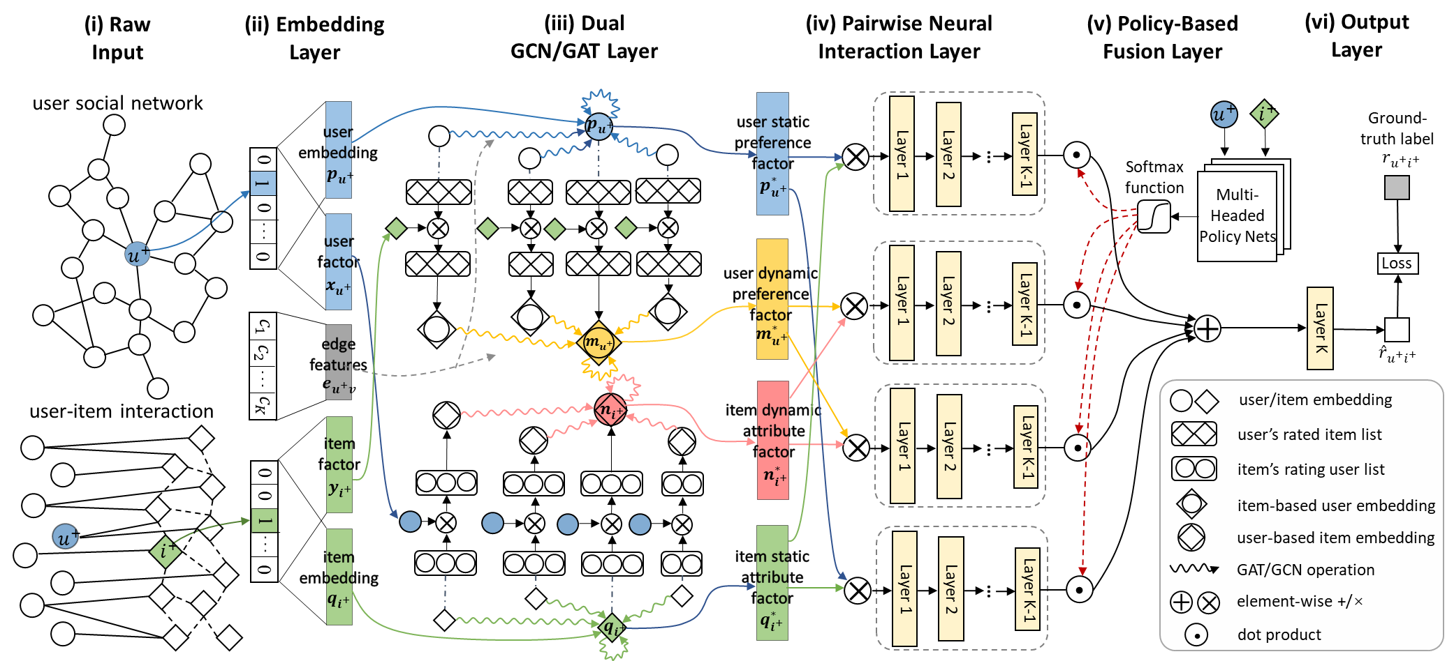
Our Model: DANSER
·
·
social homophily
social influence
The Web Conference 2019
Qitian Wu @ SJTU
Wed 15th 2019
3/21
·

Slide 6

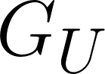

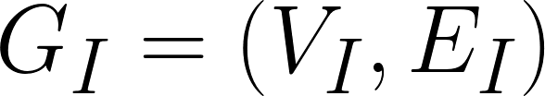
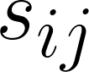
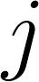
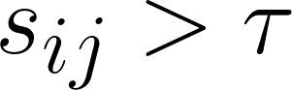
Raw Input
·
·
user social network
user-item interaction matrix
define item implicit network as graph
social homophily
social influence
similarity coefficient
of item
:
and item
number of users who clicked both items
item
is related to item
if
The Web Conference 2019
Qitian Wu @ SJTU
Wed 15th 2019
4/21
·

Slide 7

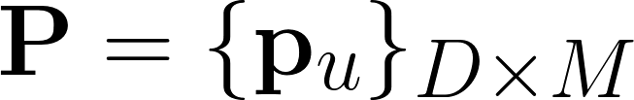
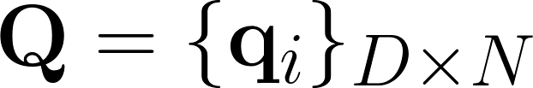
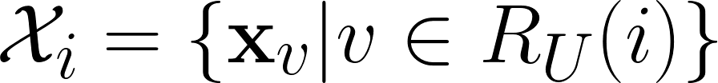
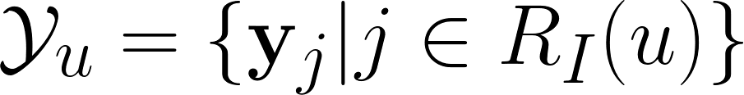
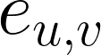
Embedding Layer
·
·
user embedding
item embedding
user factor
item factor
edge features
social homophily
social influence
The Web Conference 2019
Qitian Wu @ SJTU
Wed 15th 2019
5/21
·

Slide 8
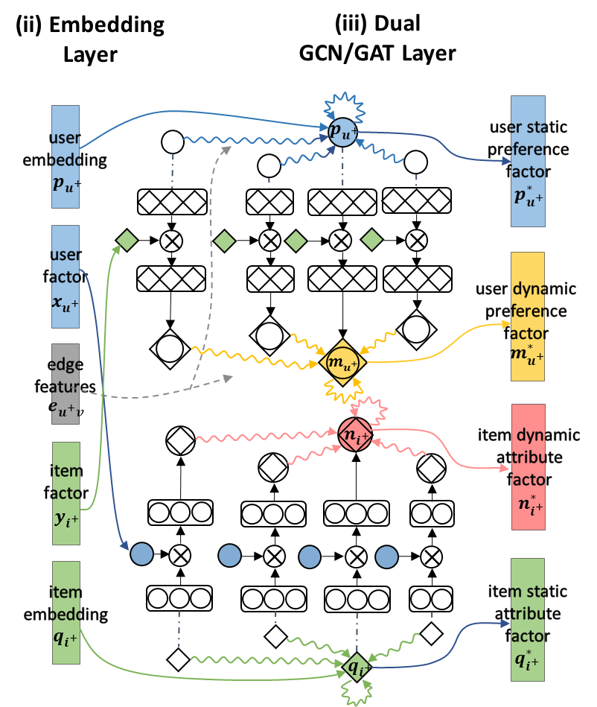
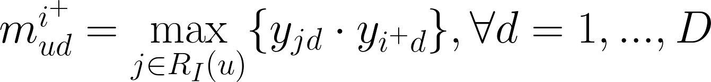
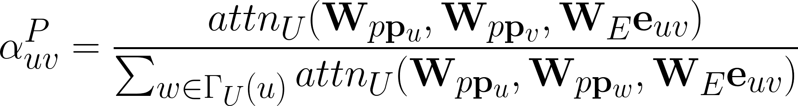
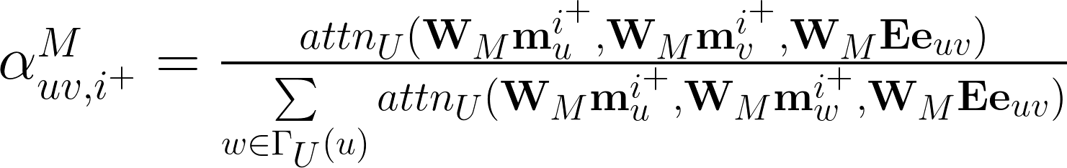
Dual GCN/GAT Layer
·
·
GAT to capture social influence (user domain)
GAT to capture social homophily (user domain)
social homophily
social influence
Formulas of GAT in item domain are similar
The Web Conference 2019
Qitian Wu @ SJTU
Wed 15th 2019
6/21
·

Slide 9
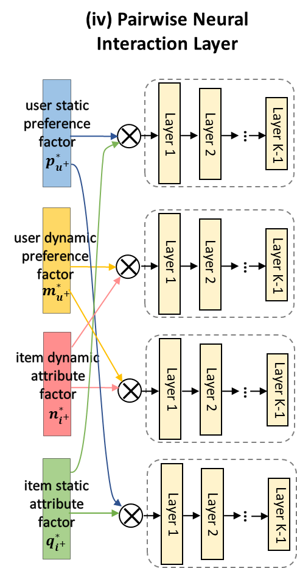
Pairwise Neural Interaction Layer
·
·
Multi-layer fully-connected neural networks
social homophily
social influence
The Web Conference 2019
Qitian Wu @ SJTU
Wed 15th 2019
7/21
·

Slide 10
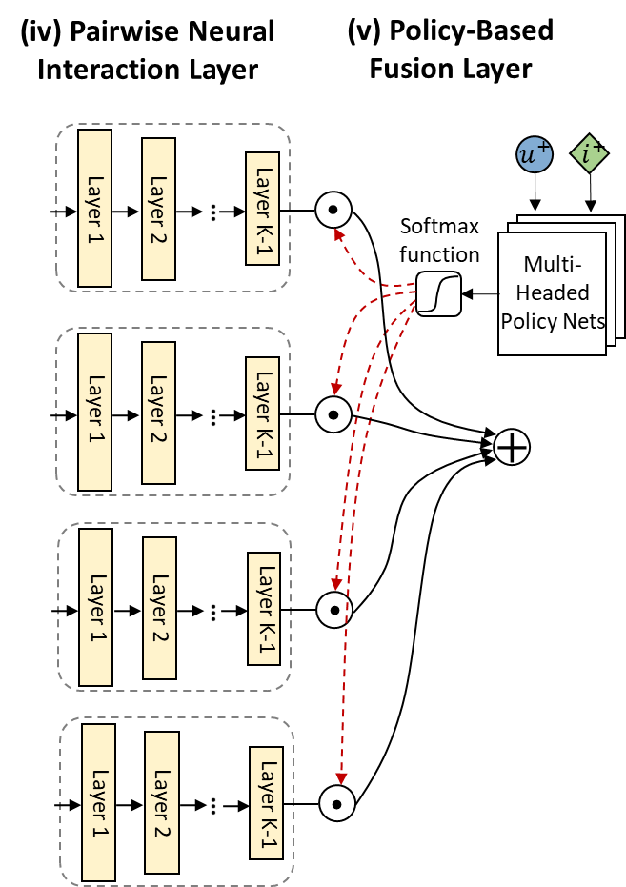
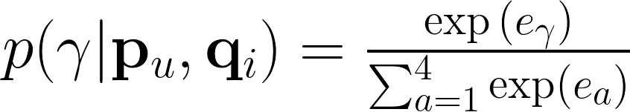
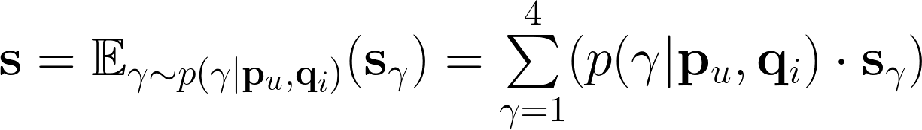
Policy-Based Fusion Layer
·
·
social homophily
social influence
The Web Conference 2019
Qitian Wu @ SJTU
Wed 15th 2019
8/21
·

Slide 11
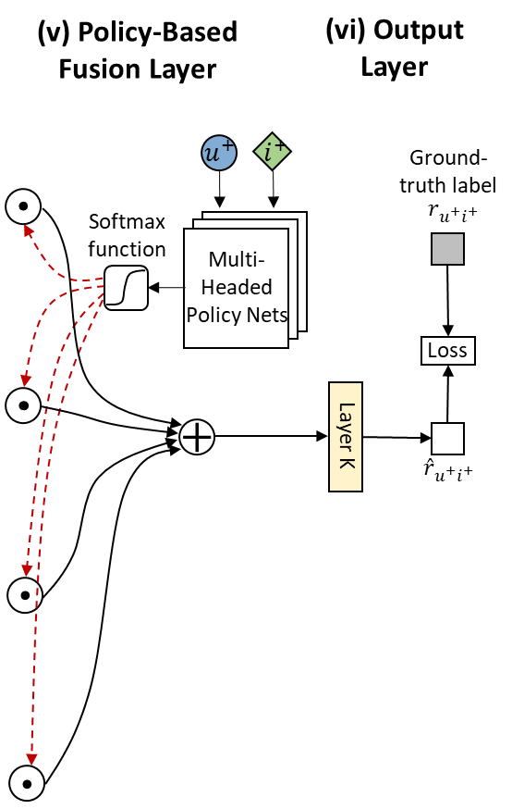
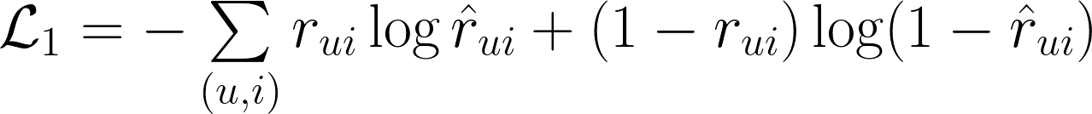
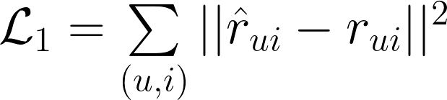
Output Layer
·
·
A fully-connected layer without activation function
implicit feedback:
social homophily
social influence
explicit feedback:
The Web Conference 2019
Qitian Wu @ SJTU
Wed 15th 2019
9/21
·

Slide 12
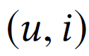
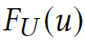
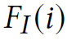
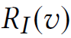
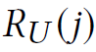
Training
·
·
Mini-Batch & Sampling
B interaction pairs for each training
Neighbored nodes for user and item
History sequence for user and item
Sample neighbored nodes
Uniformly sample F neighbored nodes for each user and item
Truncate history sequence
Truncate recent C clicked items for each user
Truncate recent C infected users for each item
Size B × F for one batch
Size B × F × C for one batch
The Web Conference 2019
Qitian Wu @ SJTU
Wed 15th 2019
12/21
·

Slide 13
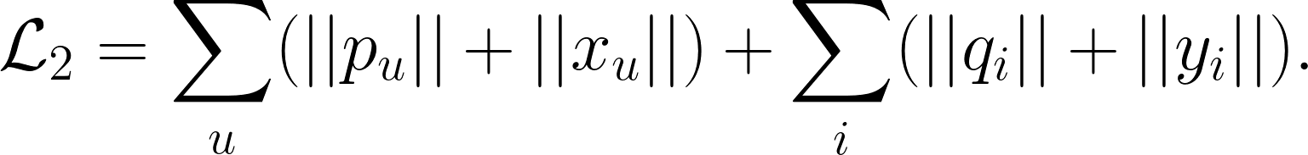

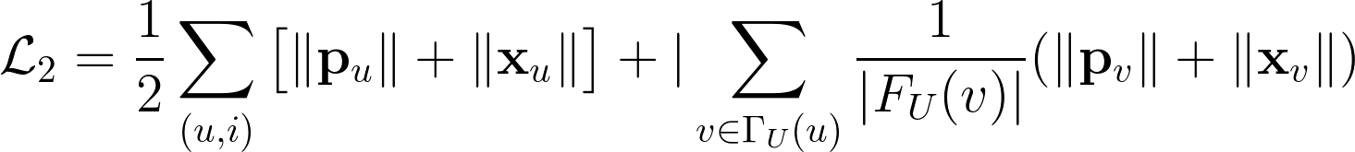
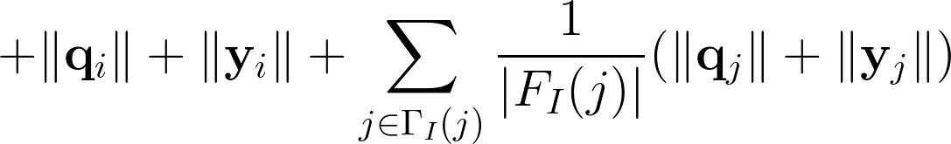
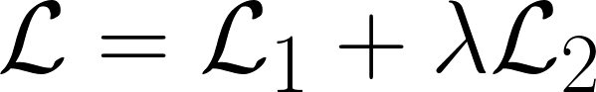
Training
·
·
Local-Graph Aware Regularization
L1 regularization
final loss function
The Web Conference 2019
Qitian Wu @ SJTU
Wed 15th 2019
10/21
·

Slide 14
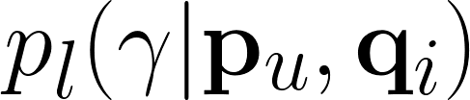
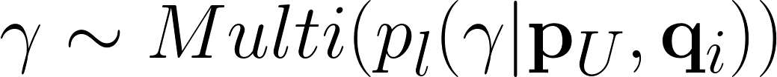
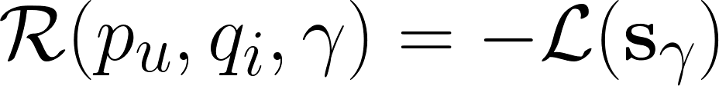
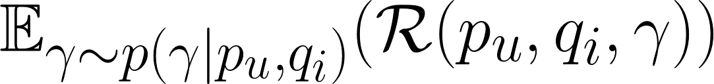
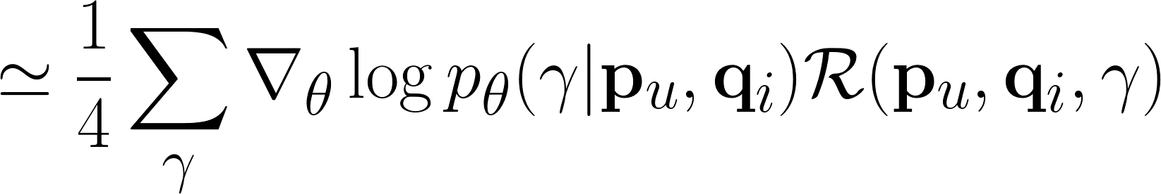
Training
·
·
Policy Gradient
l-th policy network
draw
maximize the expected reward
calculate gradient
The Web Conference 2019
Qitian Wu @ SJTU
Wed 15th 2019
11/21
·

Slide 15
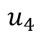
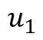
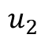
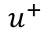
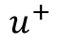
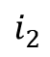
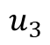
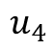
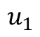
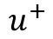
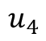













Justification of Dual GATS
·
·
$$i_{1}^{}$$
$$i_{2}^{}$$
$$u_{1}$$
$$u_{2}$$
$$u_{1}$$
$$u_{2}$$
item
$$u^{+}$$
$$u^{+}$$
user who rated the item
$$u_{3}$$
$$u_{4}$$
$$u_{3}$$
$$u_{4}$$
user who did not rate the item
(a) Previous social recommendation methods
$$i_{1}^{}$$
$$i_{2}^{}$$
force by static
weight
$$u_{1}$$
$$u_{2}$$
$$u_{1}$$
$$u_{2}$$
force by social homophily GAT
$$u^{+}$$
$$u^{+}$$
force by social influence GAT
$$u_{3}$$
$$u_{4}$$
$$u_{3}$$
$$u_{4}$$
(b) Proposed model DANSER
The Web Conference 2019
Qitian Wu @ SJTU
Wed 15th 2019
14/21
·

Slide 16


Experiments
·
·
Epinion (public dataset)
Datasets
WeChat (commercial dataset)
The Web Conference 2019
Qitian Wu @ SJTU
Wed 15th 2019
15/21
·

Slide 17
Experiments
·
·
Evaluation Protocol
Data partition
For Epinions, randomly 80% for training and 20% for testing
For Wechat, sequentially 90% for training, 10% for testing
Evaluation metrics
For Epinions, MAPE and RMSE for accuracy of 1~5 score prediction
For Wechat, Precision@10 and AUC for accuracy of 0-1 classification
Implementation
Python with Tensorflow + GTX 1080 GPU with 8G memory
The Web Conference 2019
Qitian Wu @ SJTU
Wed 15th 2019
16/21
·

Slide 18
Experiments
·
·
Competitive Methods
Collaborative filtering
SVD++
Basic collaborative filtering method
DELF
Dual embedding method – IJCAI’18
Social recommendation
Trust propagation – SIGIR’11
TrustPro
TrustMF
Trust matrix factorization – IJCAI’13
TrustSVD
Trust matrix factorization – AAAI’15
NSCR
Graph regularization – SIGIR’17
SREPS
Network embedding – AAAI’18
The Web Conference 2019
Qitian Wu @ SJTU
Wed 15th 2019
16/21
·

Slide 19


Experiments
·
·
Table1: Comparative results for Epinions and
Wechat. For MAE, RMSE, the smaller value is
better and vice versa for P@10, AUC.
Table2: Ablation study of components in proposed method
The Web Conference 2019
Qitian Wu @ SJTU
Wed 15th 2019
17/21
·

Slide 20

Case Study
·
·
Figure3: Visualization of the four GAT’s weights for a case study
The Web Conference 2019
Qitian Wu @ SJTU
Wed 15th 2019
19/21
·

Slide 21
Conclusions
·
·
Our contributions can be summarized as follows
·
General Aspects: 4 different social effects in recommendation (heterogeneous and dynamic)
Novel Methodologies: GAT + policy fusion
Multifaceted Experiments: comparison + ablation study + parameter sensitivity + interpretable visualization
The Web Conference 2019
Qitian Wu @ SJTU
Wed 15th 2019
20/21
·

Slide 22
·
·
·
Available sources
Poster: Thus, #284
Paper & Codes: https://github.com/echo740/DANSER
Contact us: echo740@sjtu.edu.cn
The Web Conference 2019
Qitian Wu @ SJTU
Wed 15th 2019
21/21
·

